Slide 1
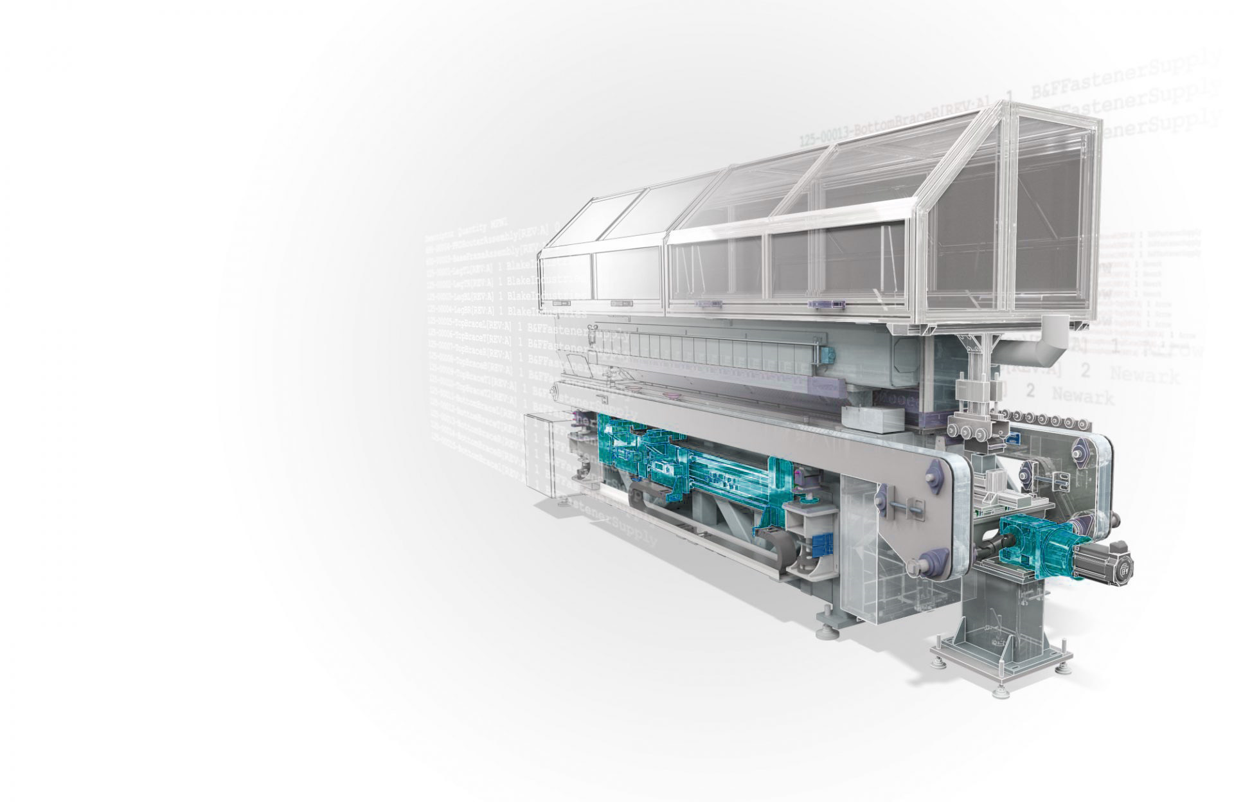


Slide 2

Who we are
WE ENHANCE
YOUR BUSINESS
We are a group of enthusiastic engineers passionate to solve engineering problems and dedicated to provide high quality design, engineering, product development, and manufacturing services for the industries that strive to achieve superior products.
Our team consists of members with well versed experience from various verticals of industries like mechanical design, electrical, electronics, and manufacturing. We aim to build up long-term cooperation and provide top notch service in design and product development areas. Allowing clients to remain focused on their business as we efficiently handle all of their design and manufacturing requirements.

Slide 3
Vision & Mission
Vision
To become a world class design and cutting edge manufacturing Company, by caring our customers and offering them innovative solutions.
Mission
Our mission is to respect every individual and make customers, employees and suppliers partners in progress through automation and application of latest technologies for designing the future.
Core Values
There is this notion that to grow a business, you have to be ruthless. But we know there’s a better way to grow. We believe businesses can grow with a conscience, and succeed with a soul and that they can do it with inbound. Also, our existence and prosperity is because of our customers. Customer satisfaction is paramount to our business success. Hence, we strive to exceed expectation.

Slide 4
Innovative
Good Quality
On Time
Our
Value
Care
Good Service
Excitement
Smart
Professional

Slide 5

Solutions Services
Product Innovation
Product Optimization
Manufacturing Engineering
Testing & Prototyping
New Product Development
Automation & Testing
Rapid Prototyping
Innovation Target Costing
Product Benchmarking & Teardown
Product Engineering
CAD Design and Detailing
Product optimization
Assembly Prototype (Full Scale Functional)
3D Printing
Jigs & Fixture
CNC Machining
Plastic Machining
Sheet Metal Fabrication
Assembly Prototype (Full Scale Functional)
Product Benchmarking & Teardown

Slide 6
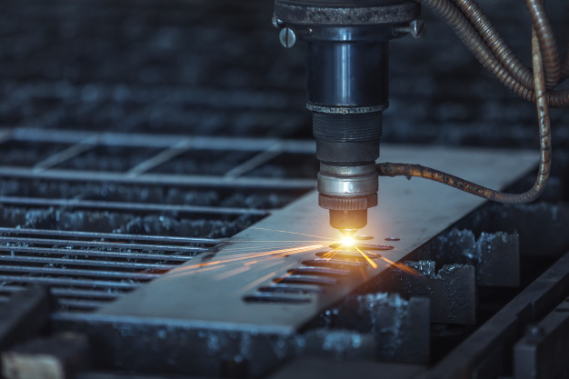
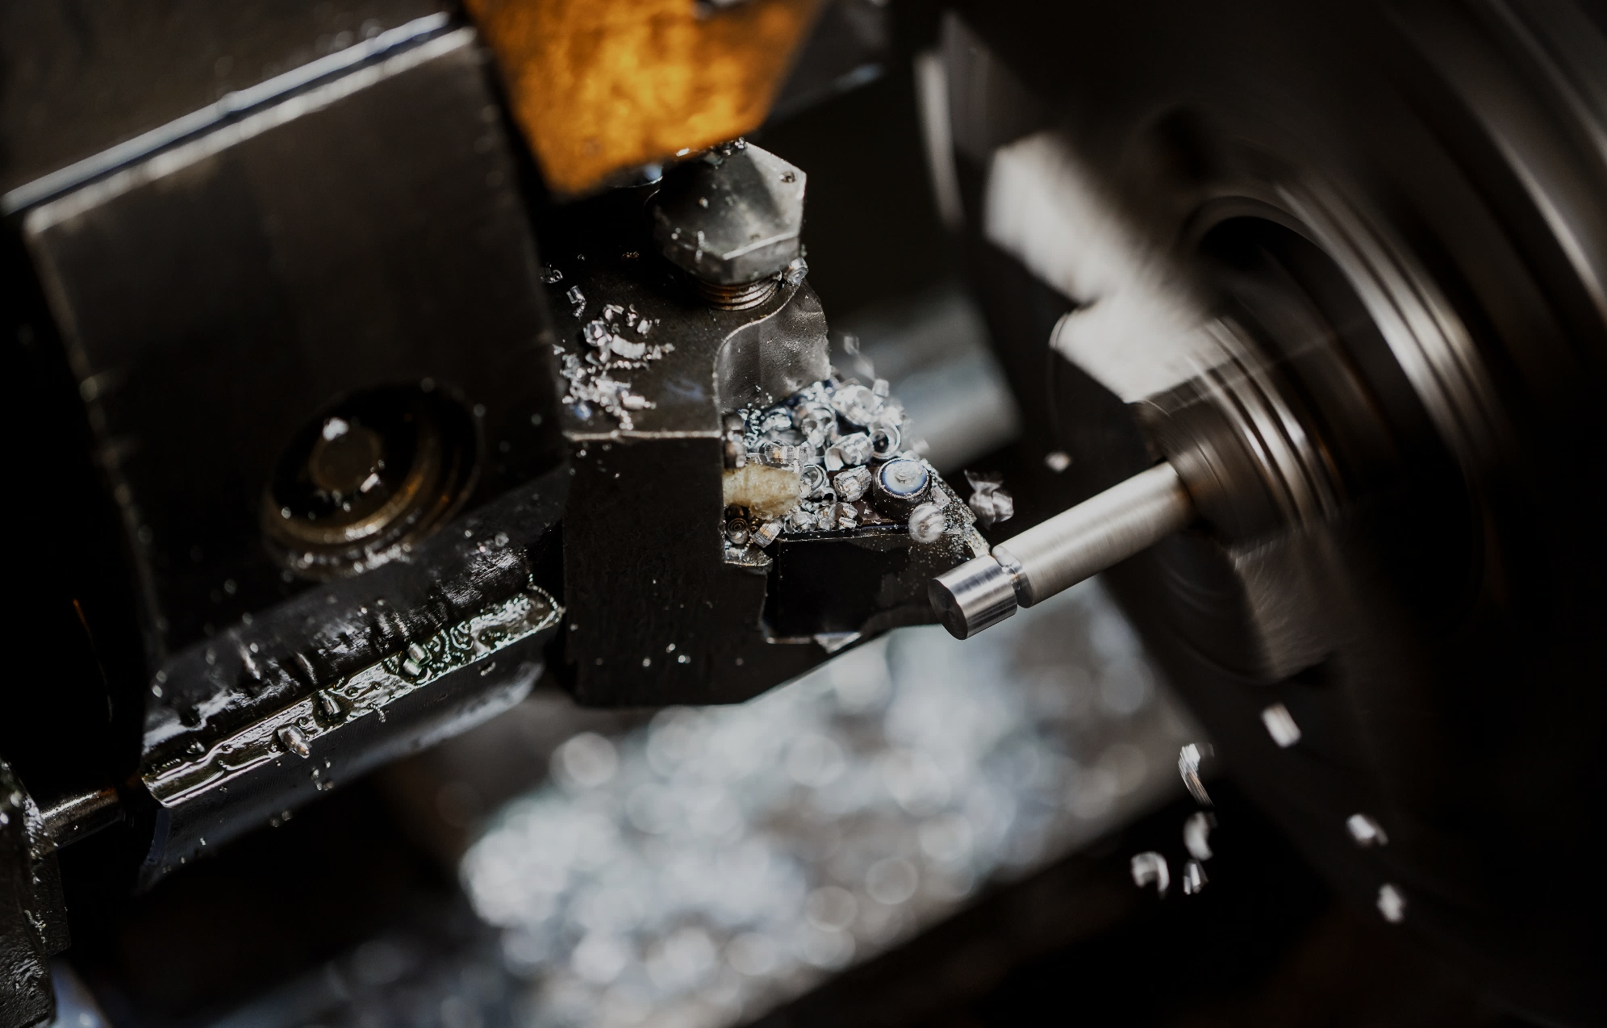
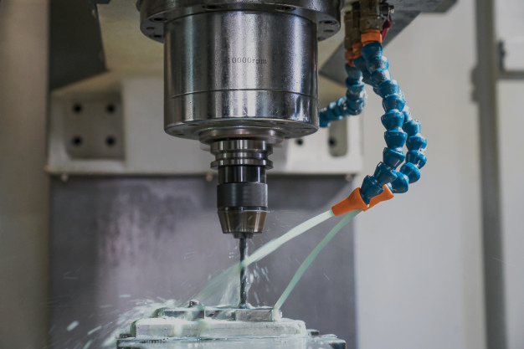

Core Competency
LASER
TURNING
CNC
WELDING

Slide 7

ENGINEERING SERVICE
Approach to R&D Projects
Feel
Field
Floor
We take the time to understand your needs and your aspirations for product design. Our prototypes help to get real-life touch and feel of your products
We visit locations where products are available to observe the products and take feedback. We engage with users to get a better understanding of their needs
We get on the shop floor to understand for thorough examination of application study, get insights and endure the designs are manufacturable.

Slide 8

Engineering Services
2D to 3D Conversion
Conversion of 2D drawings from the print, dwg/dxf or image format to high quality feature based parametric 3D models is our expertise area.
Surface Modeling
Innovation and creativity are the two vital needs of the industry and we help companies by improving the aesthetic appeal of their products. In Surface modeling our product design team involves in generating aesthetic features to improve the styling and appearance of the products. We provide the product concept for review and presentation and also create animation for realistic appeal. The presentation can be delivered in video ﬁles as well as PowerPoint presentations.
3D to 2D Conversion
There is an immense need in the industry for development of 2D drawings from the models generated by designers. Typically for reverse engineered and concept models, there is a need to create product and manufacturing drawings as per the sample drawings or drawing generation standards. Toolabs helps companies in this niche area by providing deep engineering and CAD tool expertise for delivery of product drawings.
Assembly Modeling
Product designers produce General Assembly layout (Skeleton Layout) of the product to be manufactured. We have expertise to develop the assembly from the given layout, using top down conﬁguration, interference detection check and ensuring physical interaction of components using physical dynamics. We create multiple conﬁguration of the assembly, apply corresponding materials to the components, and generate assembly drawing with Bill of Materials and recommendations based on customer input.
3D Parametric Solid and Surface Modeling
We have expertise and facility to generate 3D feature based parametric models (with part history) for casting, sheet metal components, plastic products, etc. We bring in value by generating models based on the product idea, arriving at various concept models and incorporating functional design and safety standards.
Reverse Engineering
Reverse Engineering techniques are eﬀectively used in scenarios where physical models may require digital interpretation for enhancing or modifying the product tosuit a diﬀerent segment/application. We convert the given physical models or image ﬁles of the product to digital models with accuracy and integrity.

Slide 9
Our Process
Execution
Showcasing the concept and roadmap with clear representation of execution plan to achieve the desired output
Development
Collective, open, and non - judgmental brainstorm to generate fresh and creative ideas. Which are later realized in CAD
Approval
Upon approval for work with mutual consent. Work plan in created and confirmation is sent to client
Proposal
Thorough insight gathering on the subject to understand the need or requirement of the client

Slide 10
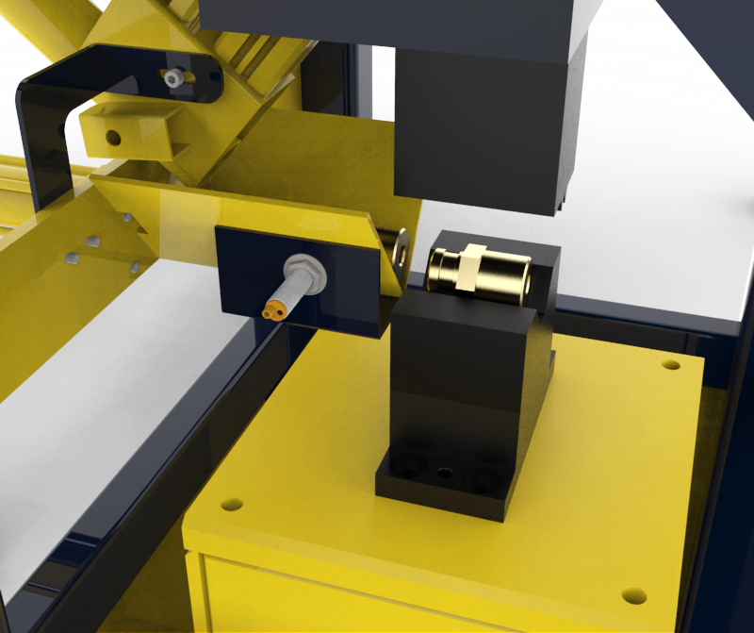
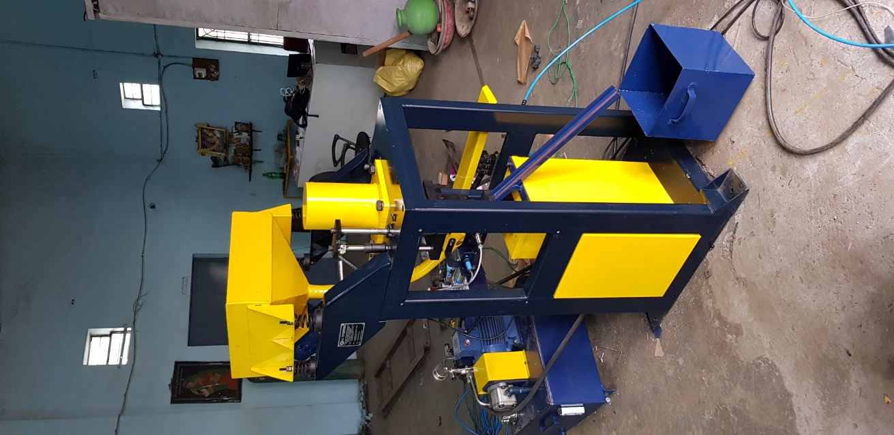
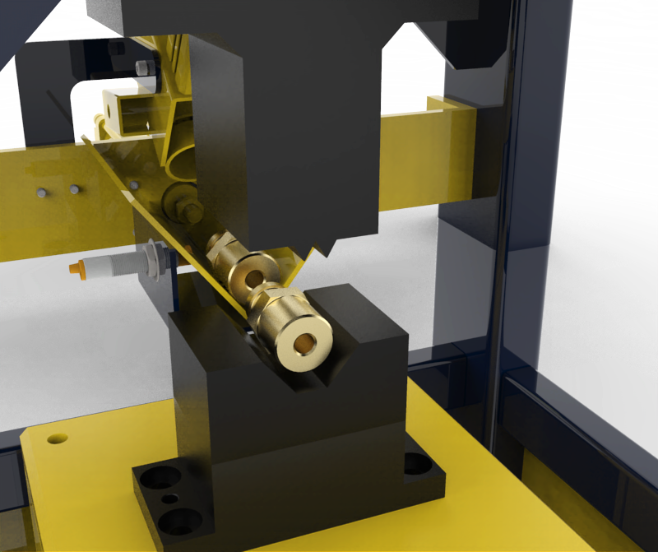
SPM
Project
Valve Crushing Machine
About Project
Cylinder Valve Crush Machine Is a fully automated special purpose machine designed to replace manually operation used to crush domestic cylinder valves. It is capable of crushing valves at the rate of 200 - 250 pieces per hour which enables high productivity.

Slide 11
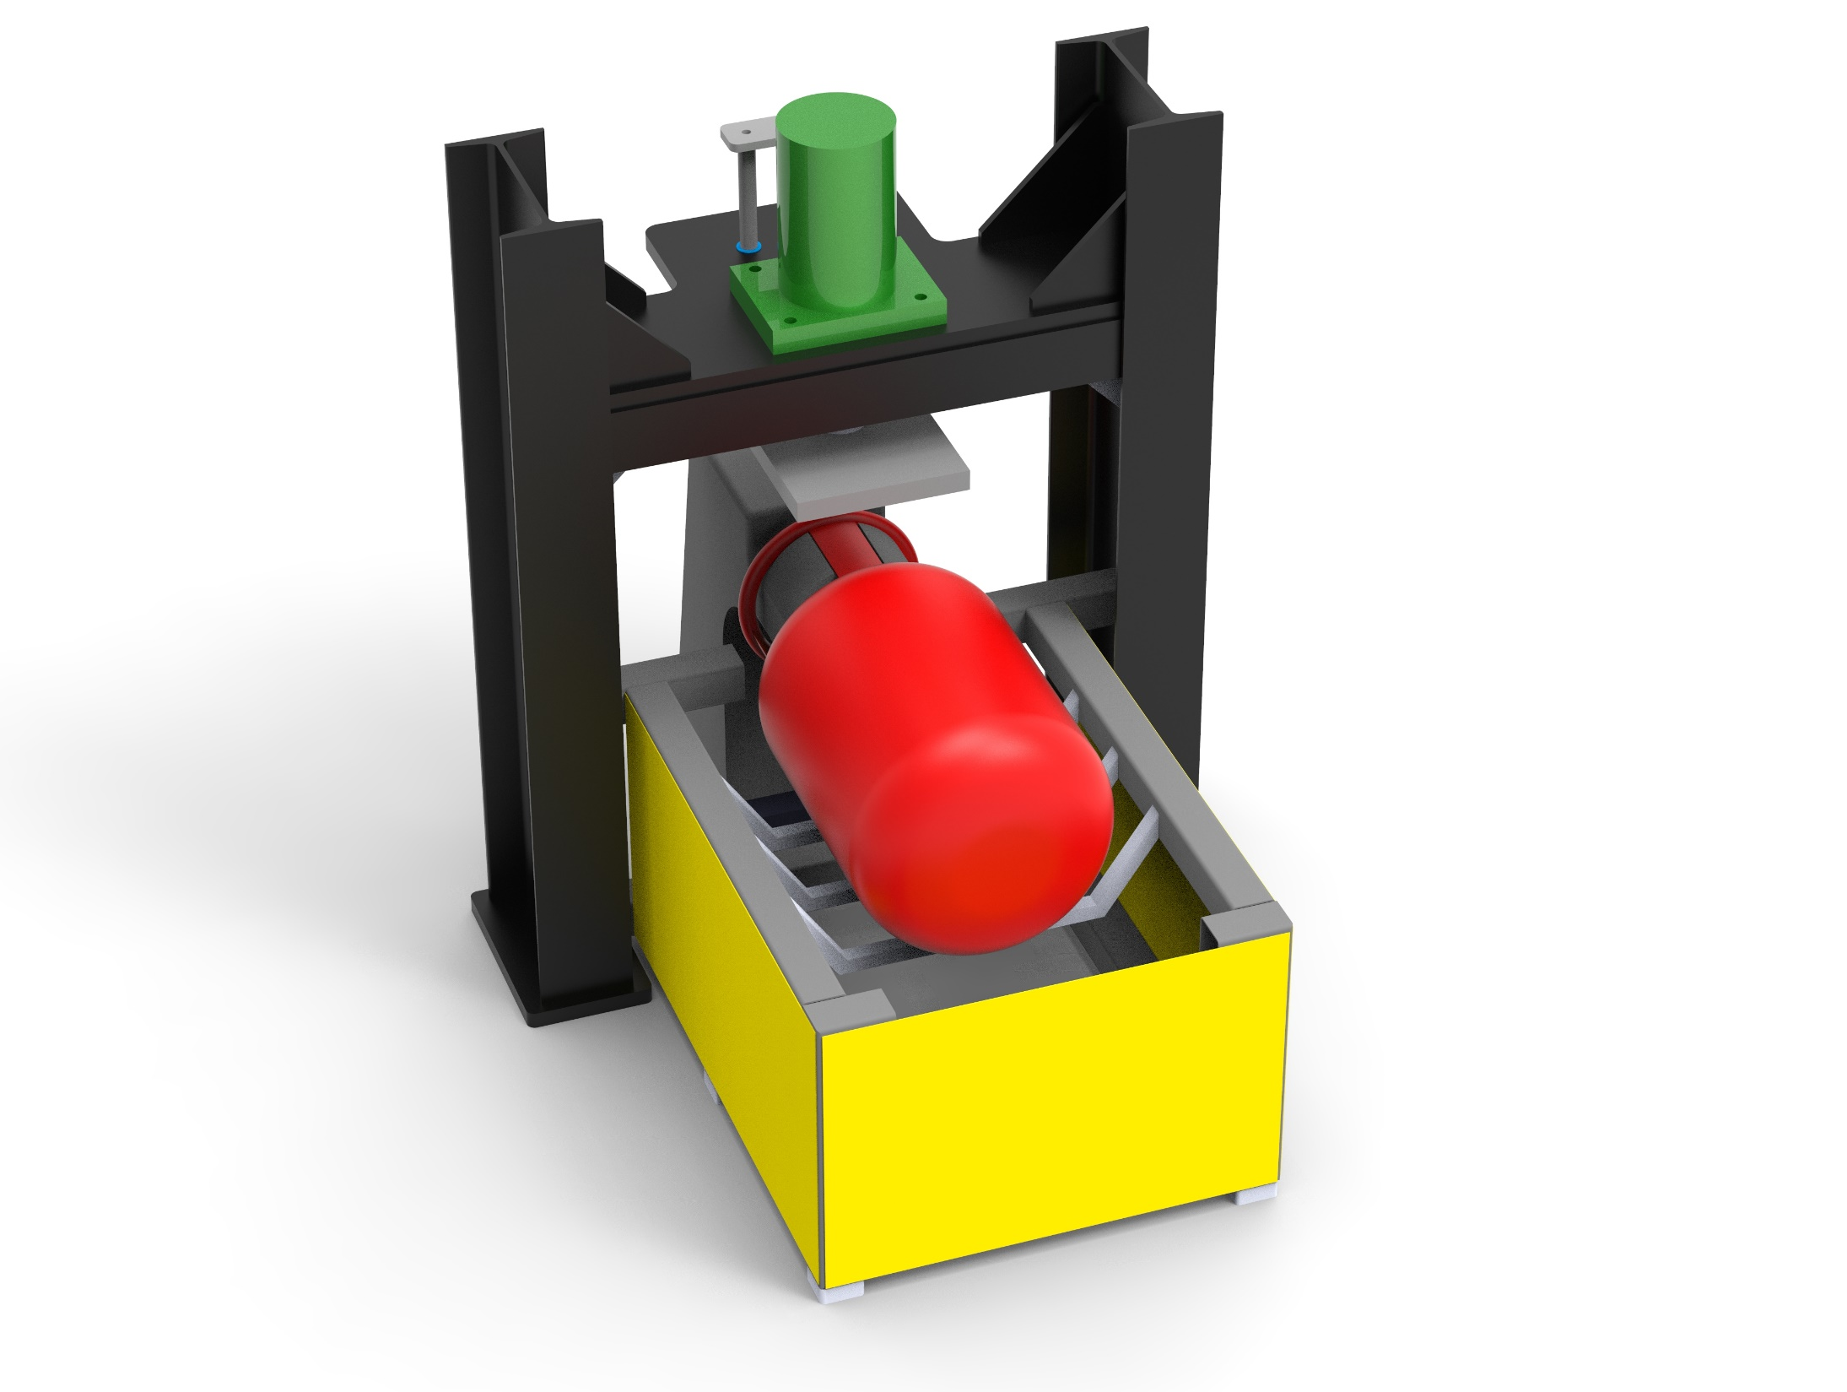
SPM
Project
Number Punching Machine
About Project
Number Punch Machine is a custom built special purpose machine to punch serial number on the domestic cylinders. This machine enables the user the ease of operating and safely punch the required numbers effortlessly.

Slide 12
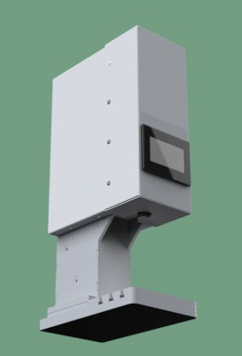
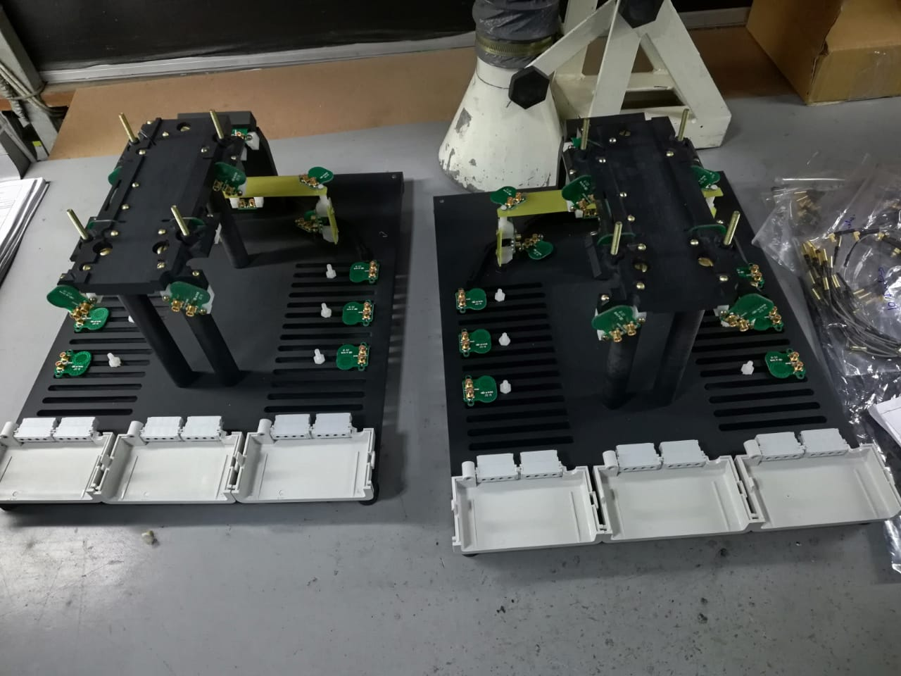
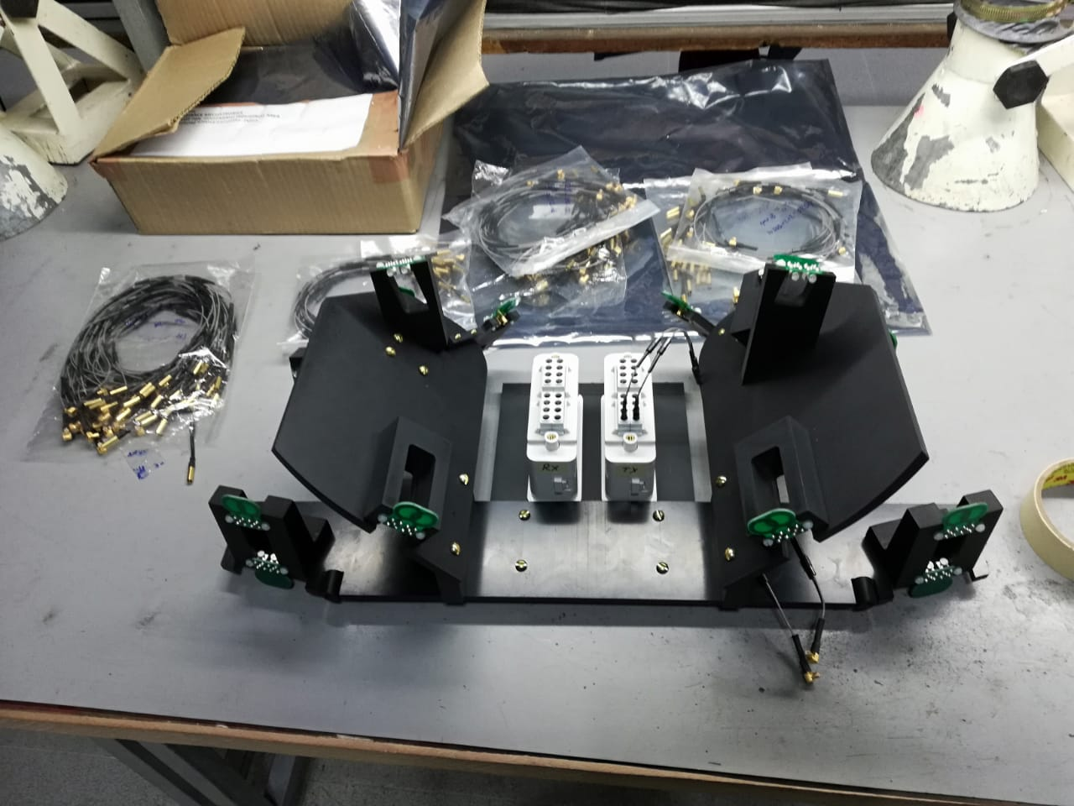
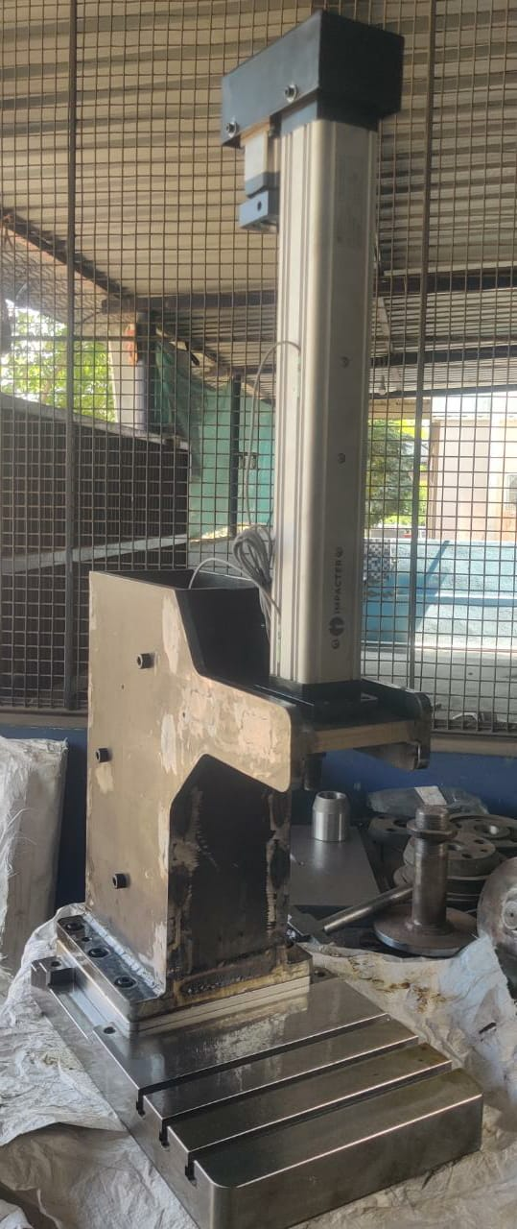
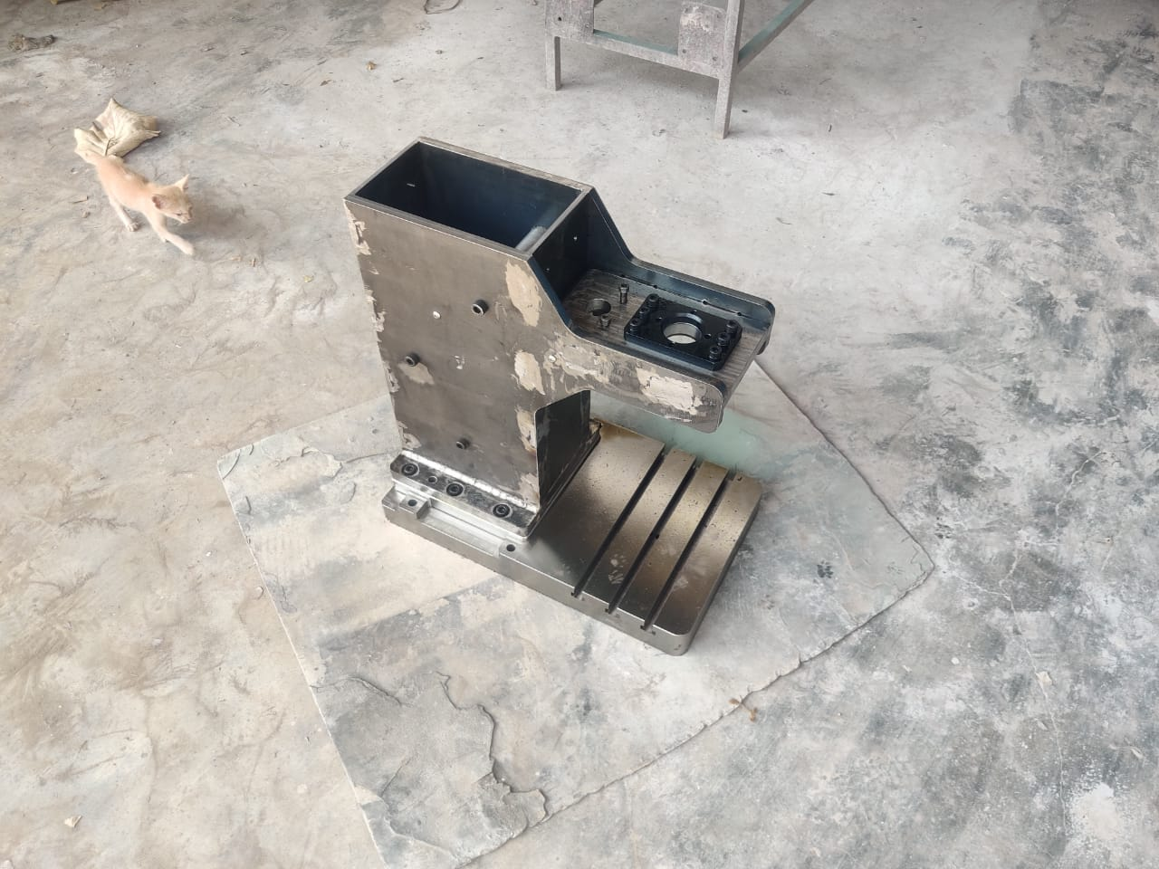
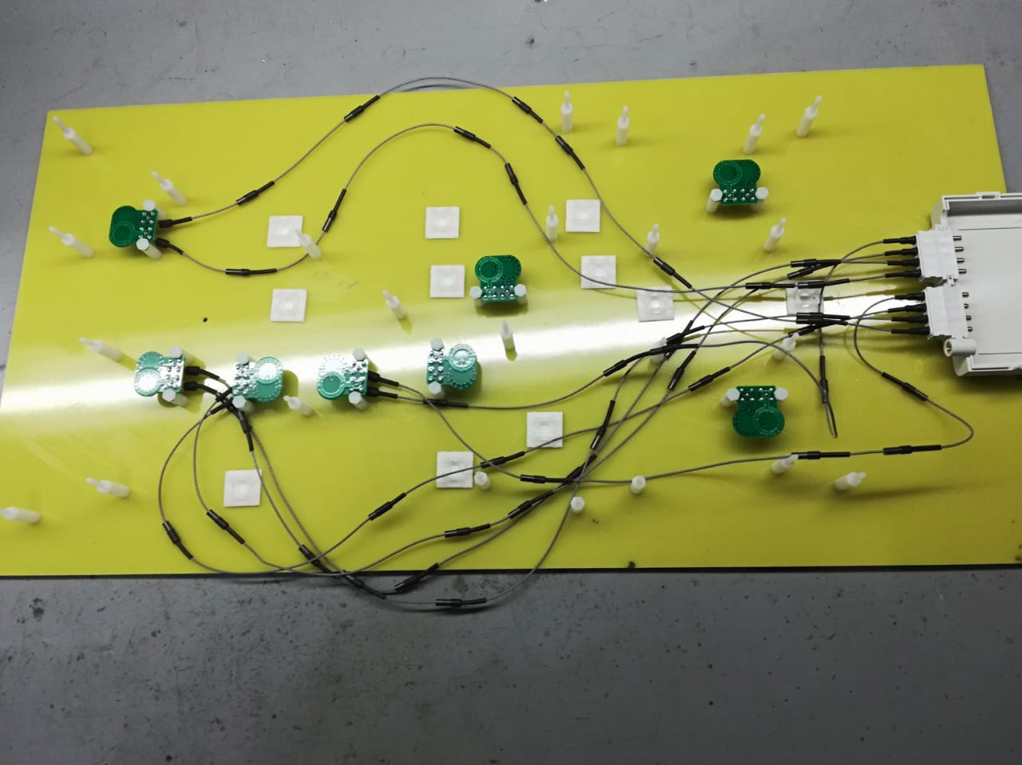
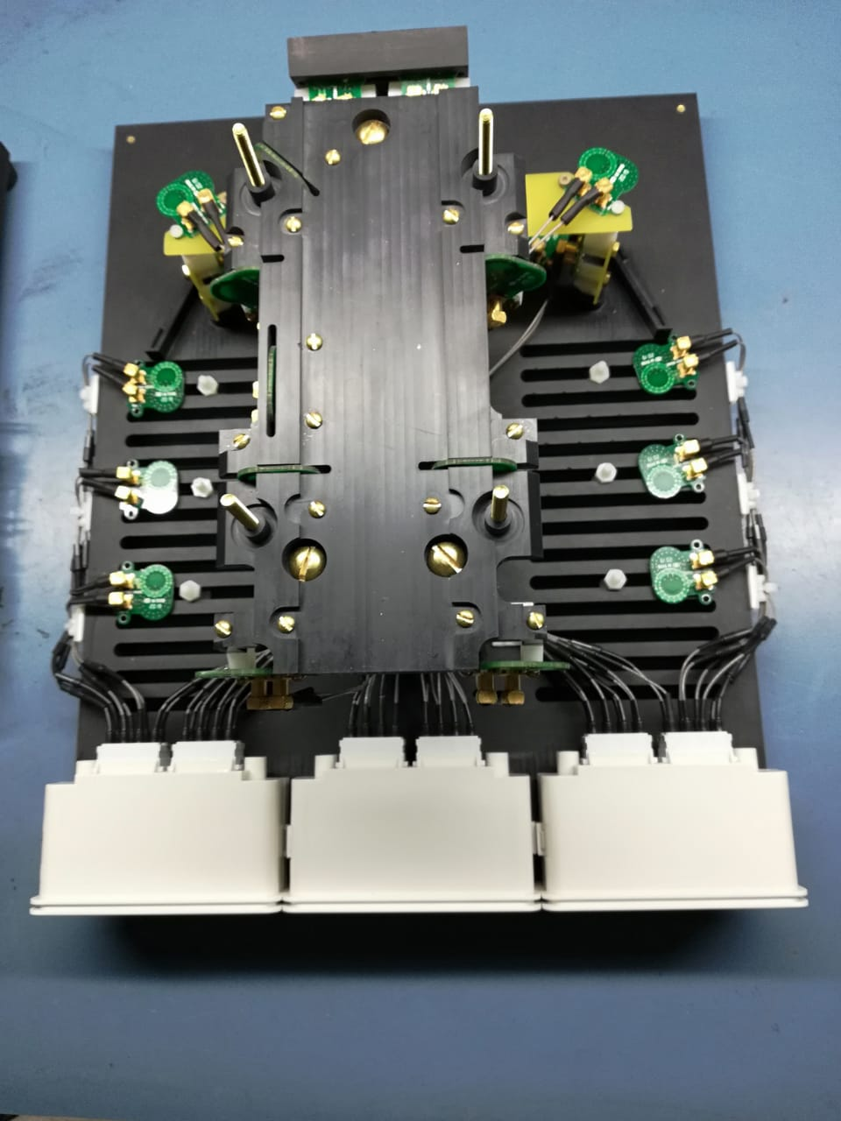
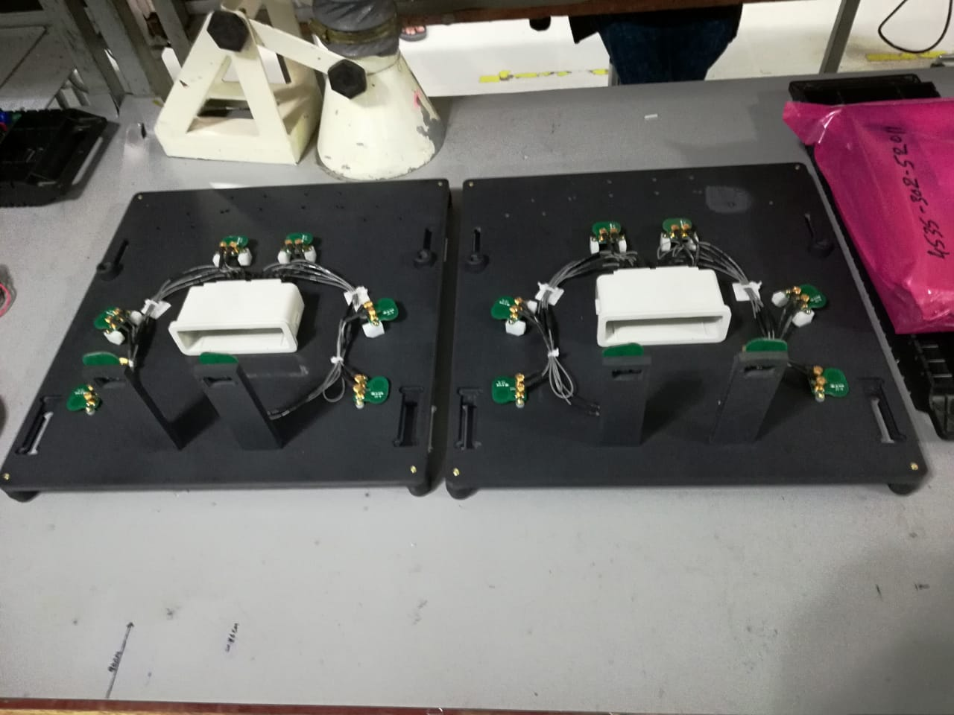
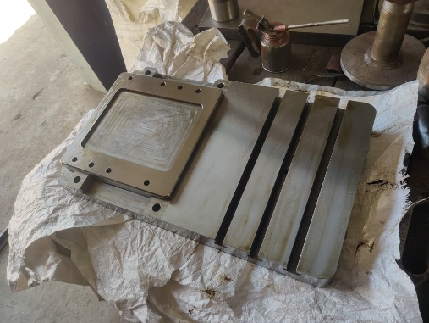
Medical Fixtures

Slide 13
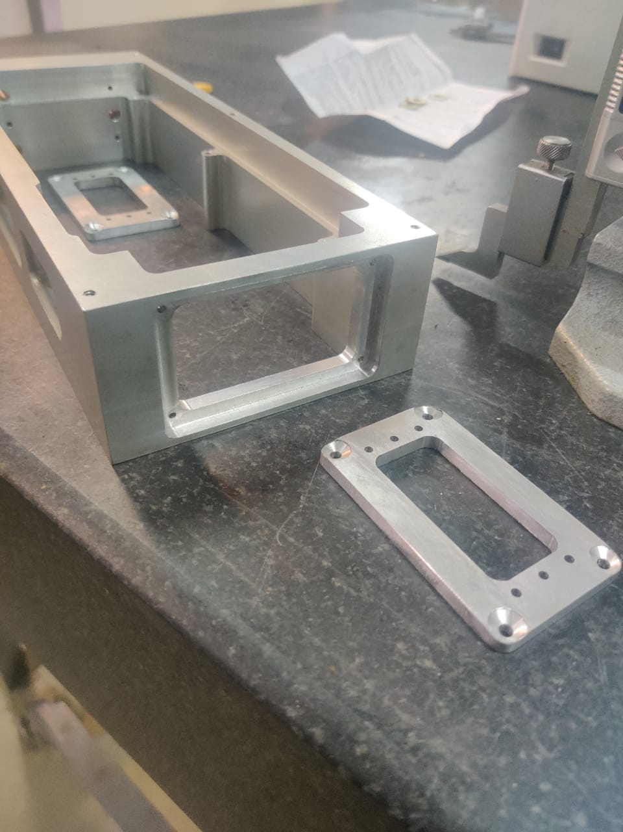
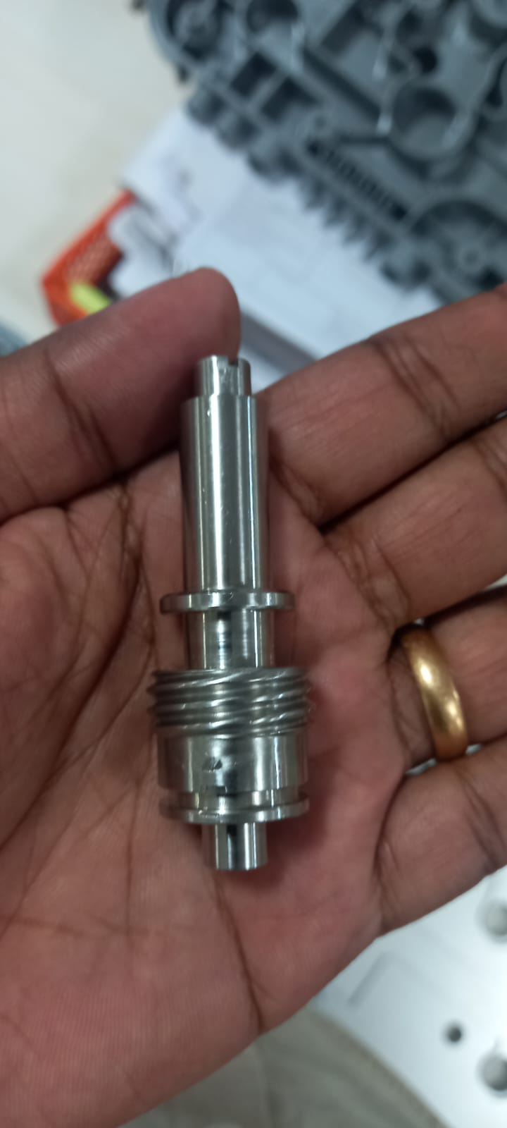
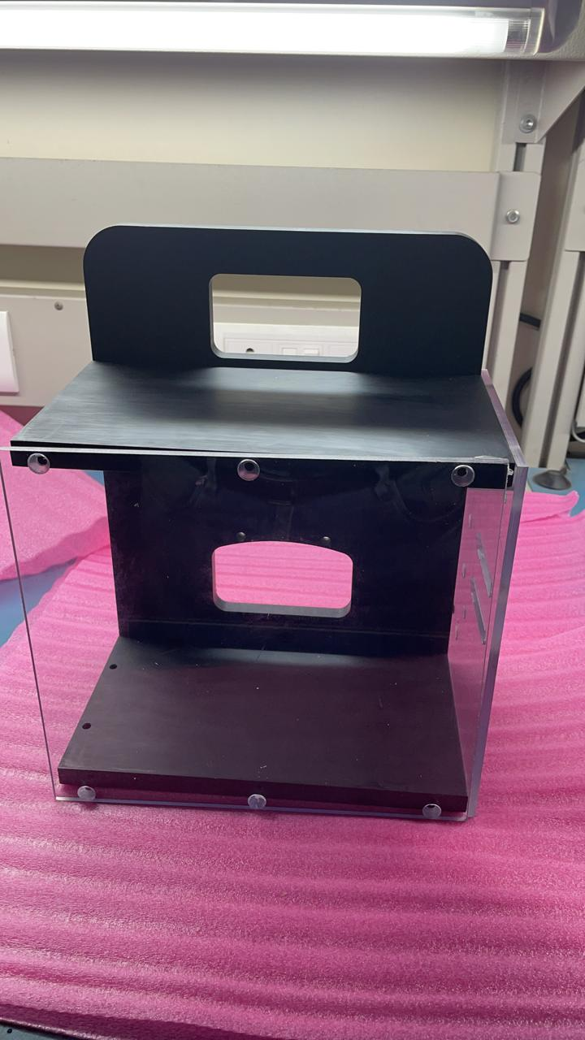
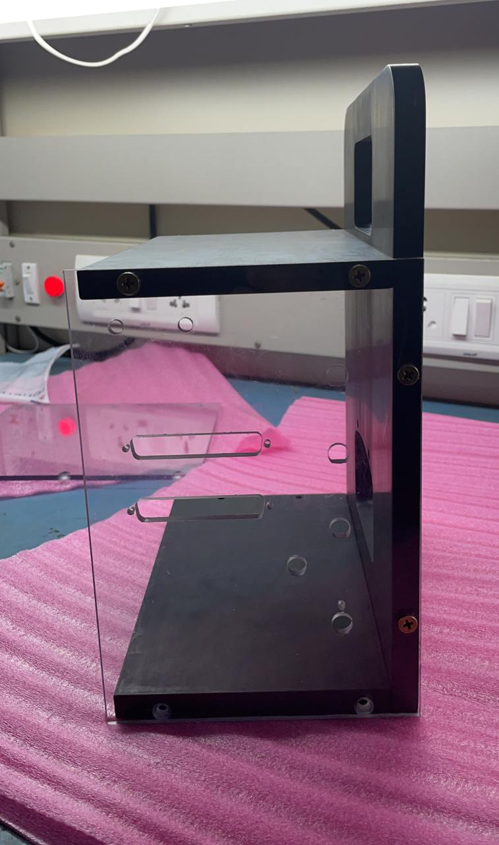
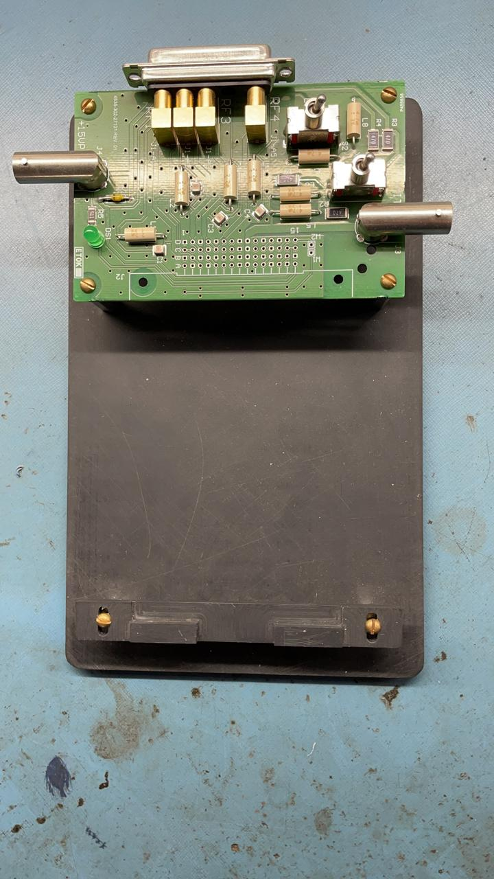
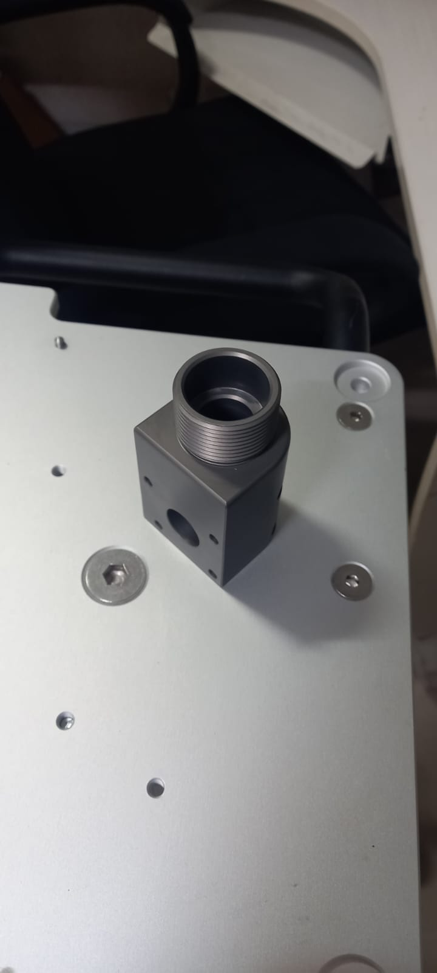
Medical Fixtures

Slide 14
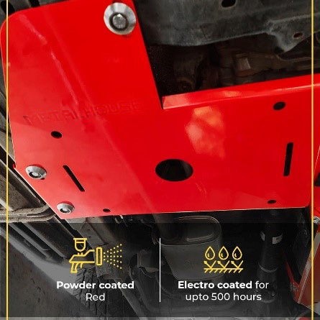
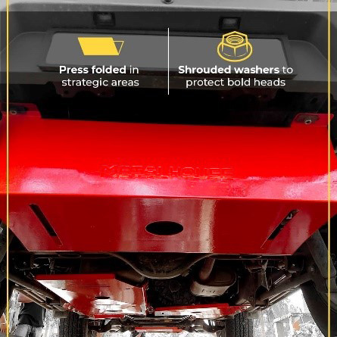
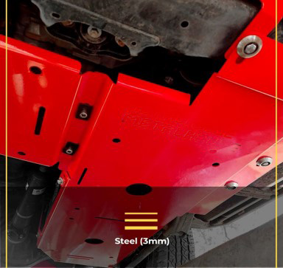
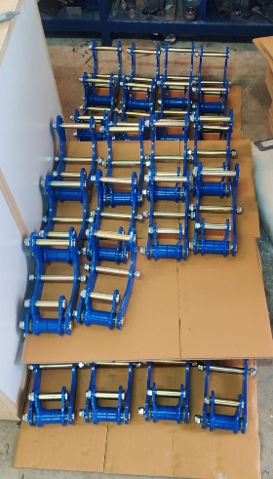
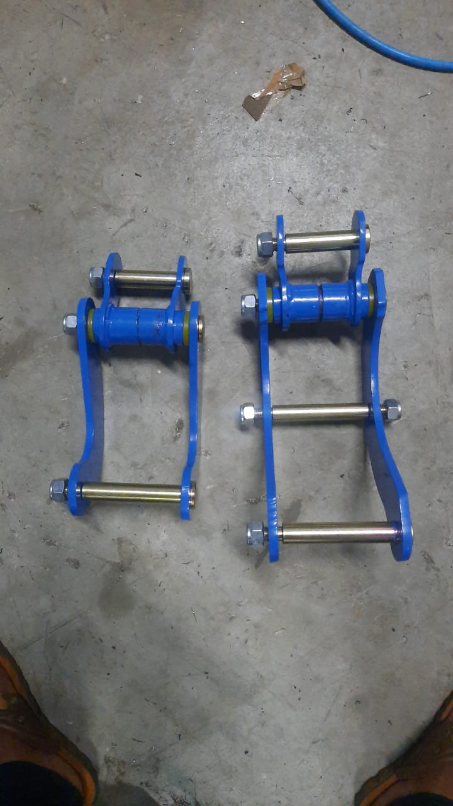
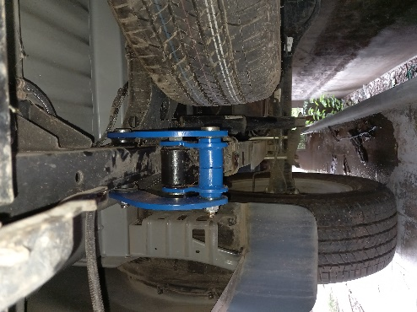
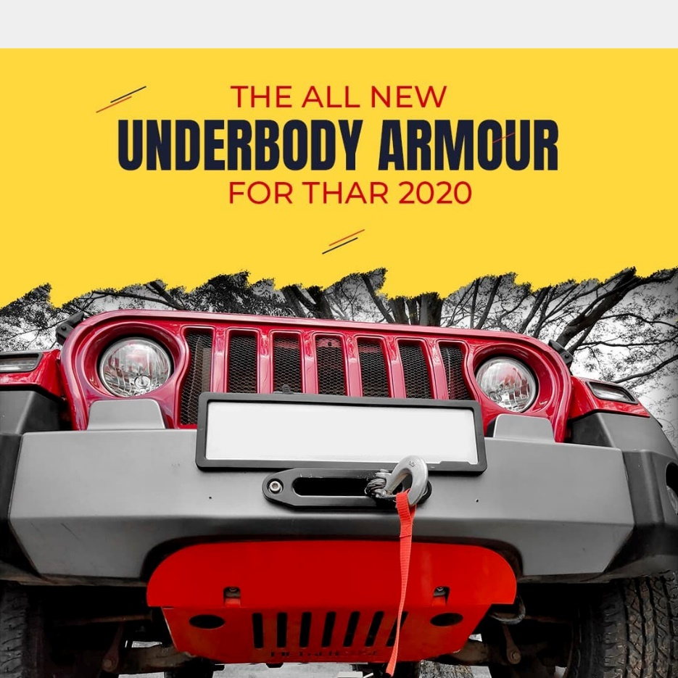
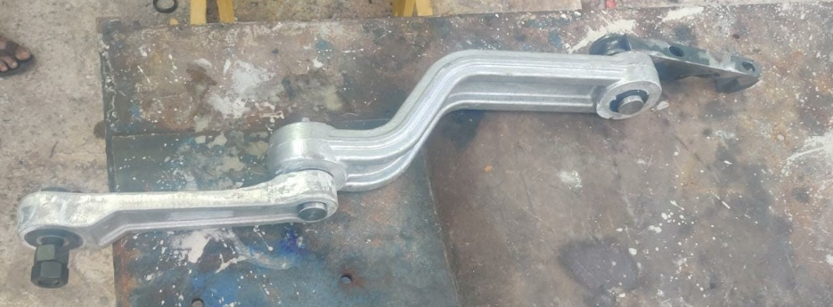
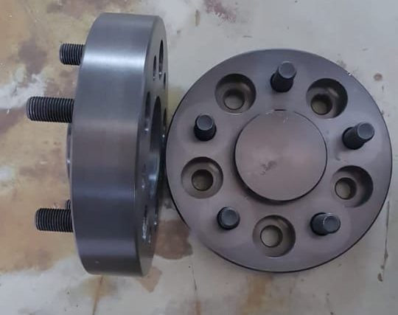
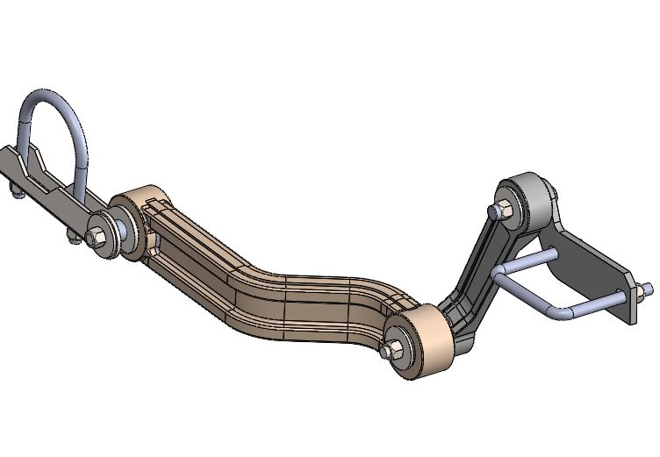
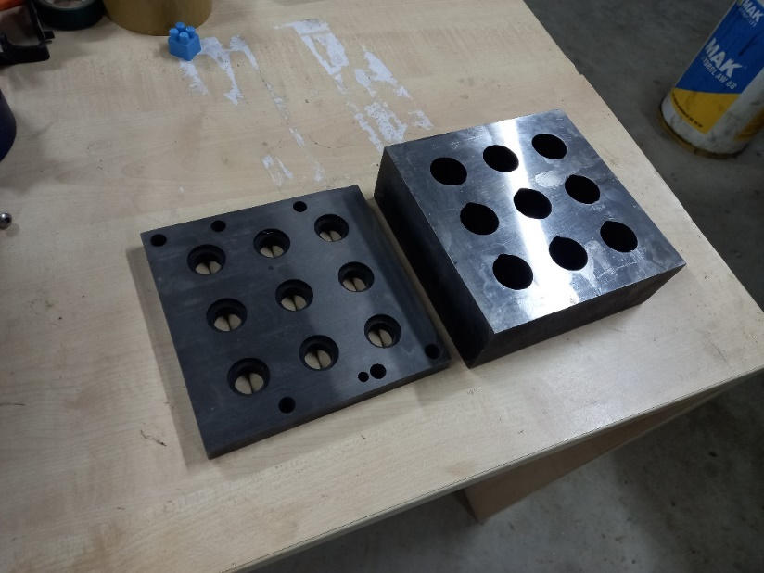
AUTOMOTIVE

Slide 15
Contact Us
A NEW BEGINNING AWAITS...
# R129, 8th Main, Hebbal Industrial Estate, Mysuru – 570016, Karnataka, India
toolabsinda@gmail.com/info@toolabs.in
+91 89518 90793

